Slide 1
NEUROFUSION ADVANCING BRAIN TUMOR DIAGNOSIS USING CNN ARCHITECTURES
Guided by
Submitted by
SUDHA R, M.TECH
D.Keerthana [210221104016]
E.Keerthi [210221104017]
N.Manimegalai[210221104022]
R.Mythily [210221104308]

Slide 2
ABSTRACT:
Glioma growth models help predict tumor progression after surgery, with Diffusion Tensor Imaging (DTI) improving accuracy by mapping tumor spread along white matter tracts. Traditional segmentation struggles with precise prediction, leading to the use of ranking-based methods like Average Precision (AP). Studies show that DTI-informed models enhance post-surgical tumor shape prediction compared to isotropic models . This project leverages Convolutional Neural Networks (CNNs) with TensorFlow for automated brain tumor segmentation. By integrating clustering techniques and DTI-based diffusion modelling , the approach improves segmentation accuracy and tumor growth prediction. This AI-driven method accelerates diagnosis, aiding early detection and enhancing treatment planning for better patient outcomes.

Slide 3
AIM:
To develop an accurate and efficient brain tumor diagnosis system using Convolutional Neural Networks (CNNs) with TensorFlow.
SCOPE:
This project focuses on developing a CNN-based brain tumor detection system using TensorFlow. It processes large-scale MRI datasets to improve classification accuracy and evaluates performance using key metrics like accuracy, sensitivity, and specificity. The system aims for real-world clinical integration, enhancing diagnostic workflows and aiding in early tumor detection.

Slide 4
EXISTING SYSTEM:
Current methods primarily use segmentation-based approaches, assuming uniform tumor growth and relying on structural MRI without fully integrating Diffusion Tensor Imaging (DTI). These models face challenges in personalizing tumor predictions and struggle with real patient data validation
Disadvantages:
Uses only one architecture
High computational time.
No Django-based deployment.

Slide 5
PROPOSED SYSTEM:
The proposed system leverages CNNs and TensorFlow for precise tumor detection, incorporating image preprocessing and feature extraction for improved classification. A Django-based framework ensures user-friendly interaction, allowing MRI uploads for automated analysis with visual result representation. Advantages include multi-architecture comparison for better accuracy, reduced computational power, and enhanced classification capabilities.
Advantages:
Compares multiple architectures for better accuracy.
Requires less computational power.
Supports classification of more than four tumor types.

Slide 6
ENVIRONMENT REQUIREMENTS:
1. Software Requirements:
Operating System : Windows
Tool : Anaconda with Jupyter Notebook
2. Hardware requirements:
Processor : Pentium IV/III
Hard disk : minimum 80 GB
RAM : minimum 4 GB

Slide 7
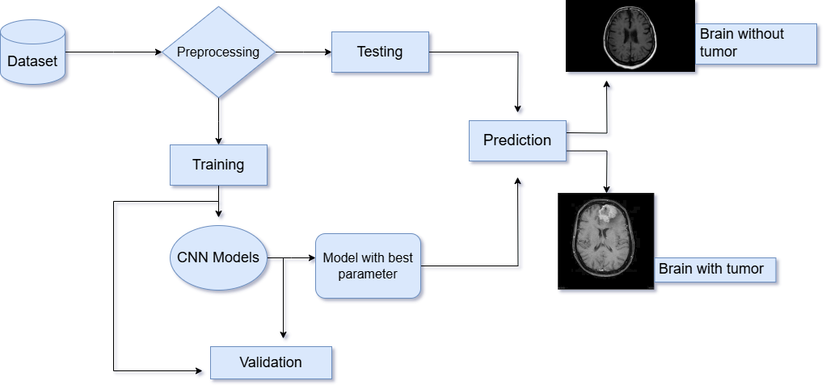

Slide 8
LITERATURE SURVEY:
NO | TITLE | AUTHOR&YEAR | METHODOLOGY | ADVANTAGE | DISADVANTAGE
1. | Evaluating the Predictive Value of Glioma Growth Models for Low-Grade Glioma After Tumor Resection | Karin A. van Garderen, Sebastian R. van der Voort, etc..(2024) | The study used tumor growth models to predict glioma evolution after resection, incorporating MRI and Diffusion Tensor Imaging (DTI) data. It introduced Average Precision (AP) as a ranking-based evaluation metric instead of traditional segmentation. The model was tested on 14 low-grade glioma (LGG) patients. | MRI and DTI enhance prediction accuracy by providing detailed structural and functional data. Helps identify patients at higher risk of recurrence, guiding follow-up strategies. Provides a foundation for future, larger-scale studies. | The study’s reliance on just 14 patients limits generalizability. High-quality MRI and DTI data are required, which may not always be available. Predicting tumor growth over time is complex and uncertain

Slide 9
LITERATURE SURVEY:
NO | TITLE | AUTHOR&YEAR | METHODOLOGY | ADVANTAGE | DISADVANTAGE
2. | Integrated Biophysical Modeling and Image Analysis: Application to Neuro-Oncology | A. Mang, S. Bakas, S. Subramanian, C. Davatzikos, and G. Biros. Year: 2020 | Combined biophysical tumor growth modeling with image analysis. Integrated machine learning for personalized neuro-oncology models. Used multimodal imaging datasets for validation. | Combines quantitative tumor growth dynamics with visual data, improving prediction accuracy.. | Combining biophysical modeling with image analysis and machine learning can lead to complex models that are harder to interpret and apply in clinical settings.
3. | Simulation of Anisotropic Growth of Low-Grade Gliomas Using Diffusion Tensor Imaging | S. Jbabdi, M. Pélégrini-Issac, H. Duffau, and K. R. Swanson. Year: 2005 | Used Diffusion Tensor Imaging (DTI) to model glioma growth along white matter tracts.Compared isotropic vs. anisotropic growth patterns in simulations. | DTI provides precise modeling of glioma growth along white matter tracts | DTI data analysis can be complex and requires high-quality imaging, which may not always be available

Slide 10
LITERATURE SURVEY
NO | TITLE | AUTHOR&YEAR | METHODOLGY | ADVANTAGE | DISADVANTAGE
4. | Elastix: A Toolbox for Intensity-Based Medical Image Registration | S. Klein, M. Staring, K. Murphy, M. Viergever, and J. Pluim. Year: 2010 | Developed Elastix, an open-source toolbox for non-rigid image registration. Applied to medical imaging to improve tumor alignment across time points. | Elastix improves tumor alignment across time points in medical imaging, | Elastix can be complex to use and may require advanced expertise
5. | NnU-Net: A Self-Configuring Method for Deep Learning-Based Biomedical Image Segmentation | F. Isensee, P. F. Jaeger, S. A. A. Kohl, J. Petersen, and K. H. Maier-Hein. Year: 2021 | Developed NnU-Net, a self-configuring deep learning framework for medical image segmentation. Applied to various tumor segmentation challenges. | NnU-Net automates the configuration process for deep learning models | The computational resources required for NnU-Net can be substantial

Slide 11
MODULES
Data Collection and Preprocessing
Feature Extraction and Selection
Model Training
Tumor Detection and Classification
Evaluation

Slide 12
List of Modules
1.Data Collection and Preprocessing
Gathers MRI images of the brain.
Applies preprocessing techniques such as noise reduction, normalization, and resizing for uniformity.
2. Feature Extraction and Selection
Extracts key patterns and features from MRI images.
Uses CNN to identify tumor-related characteristics.
3. Model Training
Trains the deep learning model using TensorFlow.
Optimizes CNN architecture to improve classification accuracy.

Slide 13
List of Modules
4. Tumor Detection and Classification
Uses the trained CNN model to detect the presence of a tumor.
Classifies tumors into different categories based on extracted features.
5.Evaluation Module
Evaluates model performance using metrics like accuracy, sensitivity, and specificity.
Provides explainable AI insights for better interpretability of results.

Slide 14
Reference
[1]S. Bakas et al., “Identifying the best machine learning algorithms for brain tumor segmentation, progression assessment, and overall survival prediction in the BRATS challenge,” 2018, arXiv:1811.02629.
[2]A. Mang, S. Bakas, S. Subramanian, C. Davatzikos, and G. Biros, “Integrated biophysical modeling and image analysis: Application to neuro-oncology,” Annu. Rev. Biomed. Eng., vol. 22, no. 1, pp. 309–341, Jun. 2020.
[3]J. Lipková et al., “Personalized radiotherapy design for glioblastoma: Integrating mathematical tumor models, multimodal scans, and Bayesian inference,” IEEE Trans. Med. Imag., vol. 38, no. 8, pp. 1875–1884, Aug. 2019.
[4]N. Gaw et al., “Integration of machine learning and mechanistic models accurately predicts variation in cell density of glioblastoma using multiparametric MRI,” Sci. Rep., vol. 9, no. 1, pp. 1–9, Jul. 2019.
[5] A. K. Trip, M. B. Jensen, J. F. Kallehauge, and S. Lukacova, “Individualizing the radiotherapy target volume for glioblastoma using DTI-MRI: A phase 0 study on coverage of recurrences,” Acta Oncologica, vol. 58, no. 10, pp. 1532–1535, Oct. 2019.
[6]S. Bakas et al., “GLISTRboost: Combining multimodal MRI segmentation, registration, and biophysical tumor growth modeling with gradient boosting machines for glioma segmentation,” in Brainlesion: Glioma, Multiple Sclerosis, Stroke and Traumatic Brain Injuries (Lecture Notes in Computer Science), vol. 9556. 2016, pp. 144–155.
[7]D. Kwon, M. Niethammer, H. Akbari, M. Bilello, C. Davatzikos, and K. M. Pohl, “PORTR: Pre-operative and post-recurrence brain tumor registration,” IEEE Trans. Med. Imag., vol. 33, no. 3, pp. 651–667, Mar. 2014.
[8]F. Raman, E. Scribner, O. Saut, C. Wenger, T. Colin, and H. M. Fathallah-Shaykh, “Computational trials: Unraveling motility phenotypes, progression patterns, and treatment options for glioblastoma multiforme,” PLoS ONE, vol. 11, no. 1, Jan. 2016, Art. no. e0146617.

Slide 15
Reference
[9]E. Mandonnet et al., “Computational modeling of the WHO grade II glioma dynamics: Principles and applications to management paradigm,” Neurosurgical Rev., vol. 31, no. 3, pp. 263–269, Jul. 2008.
[10]M. L. Neal et al., “Response classification based on a minimal model of glioblastoma growth is prognostic for clinical outcomes and distinguishes progression from pseudoprogression,” Cancer Res., vol. 73, no. 10, pp. 2976–2986, May 2013.
[11]K. M. Field, M. A. Rosenthal, M. Khasraw, K. Sawkins, and A. K. Nowak, “Evolving management of low grade glioma: No consensus amongst treating clinicians,” J. Clin. Neurosci., vol. 23, pp. 81–87, Jan. 2016.
[12]L. S. Hu, A. Hawkins-Daarud, L. Wang, J. Li, and K. R. Swanson, “Imaging of intratumoral heterogeneity in high-grade glioma,” Cancer Lett., vol. 477, pp. 97–106, May 2020.
[13]D. L. Silbergeld and M. R. Chicoine, “Isolation and characterization of human malignant glioma cells from histologically normal brain,” J. Neurosurg., vol. 86, no. 3, pp. 525–531, Mar. 1997.
[14]S. Jbabdi et al., “Simulation of anisotropic growth of low-grade gliomas using diffusion tensor imaging,” Magn. Reson. Med., vol. 54, no. 3, pp. 616–624, 2005.
[15]E. Konukoglu et al., “Image guided personalization of reaction-diffusion type tumor growth models using modified anisotropic Eikonal equations,” IEEE Trans. Med. Imag., vol. 29, no. 1, pp. 77–95, Jan. 2010.

